Slide 1
Factory Pattern

Slide 2
Factory Pattern
Defines al interface for creating an object, but lets subclasses decide which class to instantiate. Factory method lets a class defer instantiation to subclasses

Slide 3
Intent
Define an interface for creating objects, but you want to let subclasses decide which class to instantiate.
Decouple requesting objects from creating objects.
Calling code doesn’t need to know what types of objects are created

Slide 4
Benefits
Factory subclass has full control over the creation process: it can return the requested type or a subclass
Factory subclass can return existing instance.
Easy to change the type of products.

Slide 5
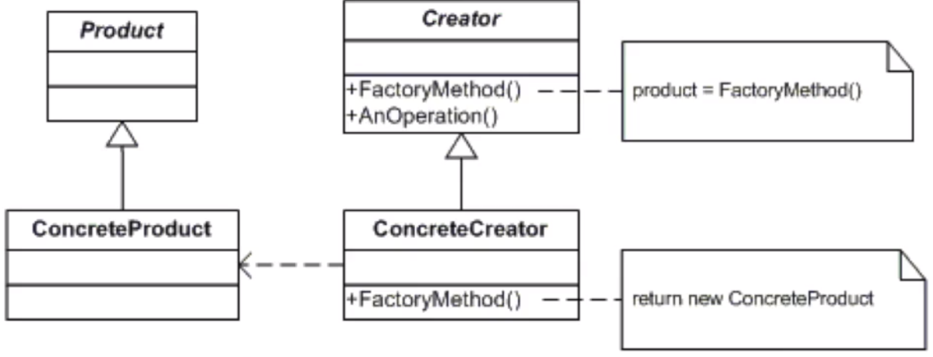
UMl

Slide 6
Checklist
Make sure you need control over how your code creates new objects
Create a concrete factory class for each type of object
Create an abstract factory that unifies all concrete factories
Make sure the client does not use new anywhere and only uses the factory method to create new instances.

Slide 7
Comments
You often see the factory method pattern and the Template method pattern together in the same code.
The Factory method can return the same instance multiple times, decoupling the act of requesting and object from the act of creating an object.
You can refactor a Factory Method pattern into a Builder as your code gets more complex.

Slide 8
Abstract Factory Pattern
Provides an interface for creating families of related or depended objects without specifying their concrete classes

Slide 9
Pattern Love: That’s applies to developers using correct design patterns in the wrong circumstances

Slide 10
Intent
Provide an interface for creating families of related or dependent objects without specifying concrete classes.
Objects can be grouped into a hierarchy that encapsulates distinct platforms consisting of a suite of related objects
Calling code works with abstract interfaces and classes and does not need to know the exact types of the objects created by the factory.

Slide 11
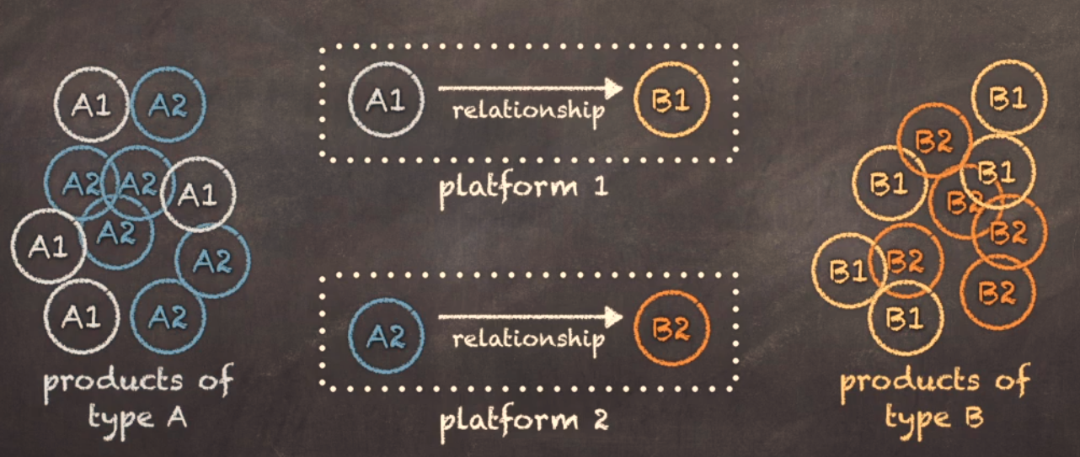
Intent

Slide 12
Benefits
Remove if-the-else blocks from construction code
Easy to exchange platforms

Slide 13
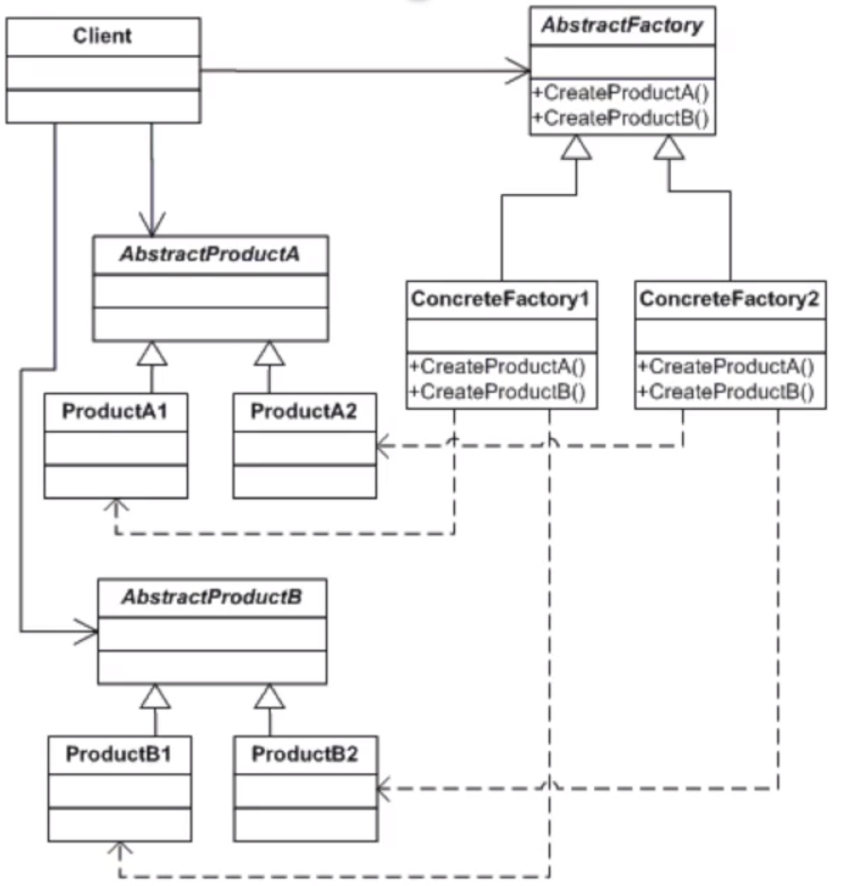
UML

Slide 14
Checklist
Make sure you have a large product family with lots of interdependencies between products, your code contains lots of switch and if statements
Create a matrix of platforms versus products
Make sure that you have at least two abstract products and platforms
Create abstract factory with create methods for each product type
Create derived factories for each platform, implement create methods.
Make sure the client doesn’t use new, only uses abstract types.

Slide 15
Coments
You can also use a Builder or Prototype pattern to create objects
You can implement the abstract factory as a singleton
You can use an abstract factory in a place of a façade.

